Slide 1
Brain Stroke Prediction app with Machine Learning
Team Tech
(18.9.2022)
Supervised by Sa Phyo Thu Htet

Slide 2
Meet Our Team
Nay Lin Tun
Phuu Pwint Thinzar Kyaing
( AI Batch-6 )

Slide 3
Agenda
Problem Statement
Impact
Objective
Project flow
Data Preprocessing
Experiment
Demo
AI Ethics
Question & Answer

Slide 4
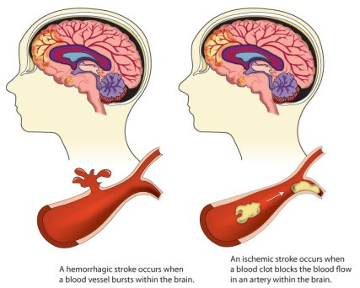
Problem Statement
What is Brain Stroke?
A stroke occurs when a blood vessel that carries oxygen and nutrients to the brain is either blocked by a blood clot or bursts.
Second leading cause of death worldwide and fifth of death women
15 million people suffer a stroke
5.5 million die
Another 5 million left permanently disabled
Main cause is High Blood Pressure.
ages of 55 and 75 people, even new moms, pregnancy does put women at higher risk for stroke
( But 4 in 5 strokes are preventable.)

Slide 5
Impact
Brain stroke is a common disease in a very hot country like Myanmar, ranks #7 in the world of stroke.
In 2020, stroke deaths in Myanmar reached even 71,440 and
about 20% of total deaths.
Our web app can help people check quickly and easily, without having to go to the hospital.
It can also be used in hospitals as a medical test.
We hope to be able to reduce the number of sudden deaths without knowing anything in advance or no treatments.

Slide 6
Objective
To predict whether a person is at risk of brain stroke
To check for yourself easily and safely or for many others in need freely

Slide 7
Project Flow
Data Preprocessing
Data Cleaning
Data Transformation
Feature Engineering
Training Data
Testing Data
Deployment
Evaluation
Modeling

Slide 8
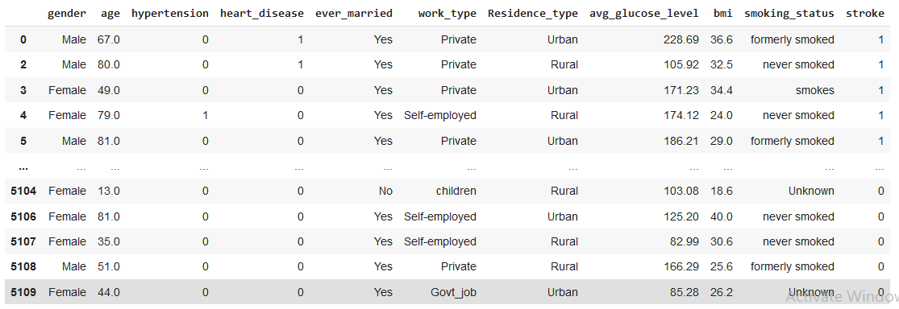
Data Preprocessing
Dataset from kaggle.com : healthcare-dataset-stroke-data.csv
Total data : 5109 records & 12 attributes

Slide 9
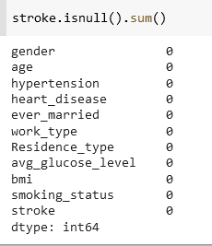
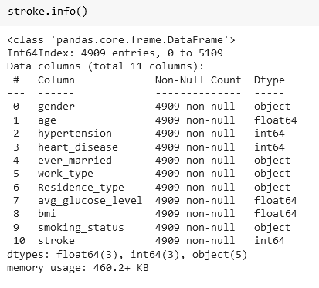
Data Preprocessing
Data cleaning
>>Checking for null values >> Removing unnecessary attribute

Slide 10
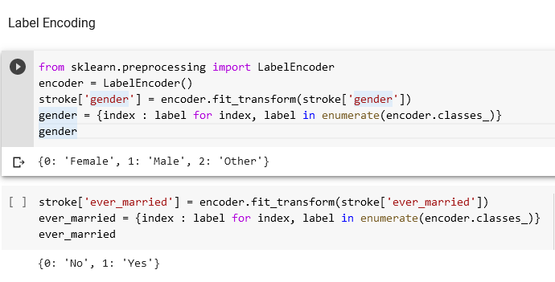
Data Preprocessing
Data Transformation
Some values in our dataset are strings (non-numerical). To access and manipulate all data, we need only numerical values which machine knows.

Slide 11
Data Preprocessing
Feature Engineering
70% Training data( Features + Label)
Brain stroke data
30% Testing data( Features + Label)
Features | Label
Gender, Age, Hypertension, Heart disease, Ever married, Work type, Residence type, Average glucose level, BMI, Smoking status | Stroke

Slide 12
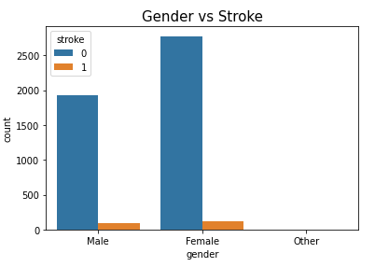
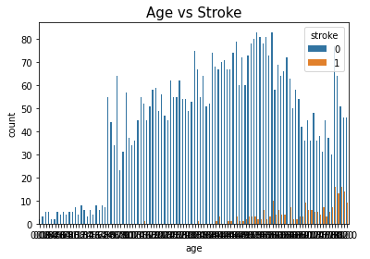
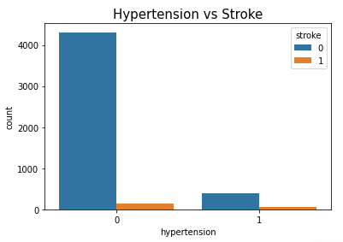
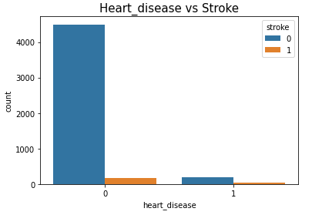
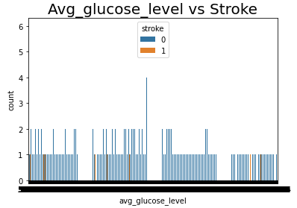
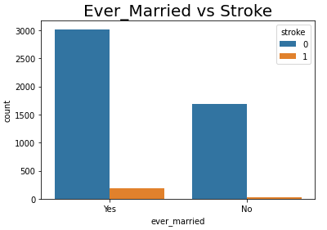
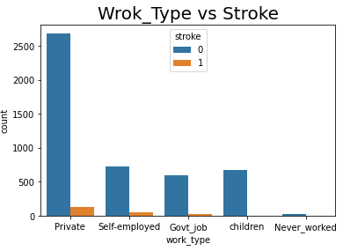
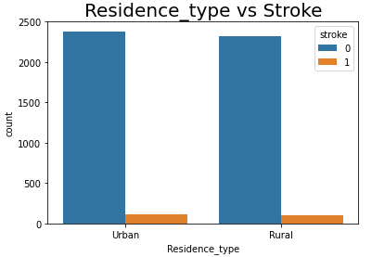
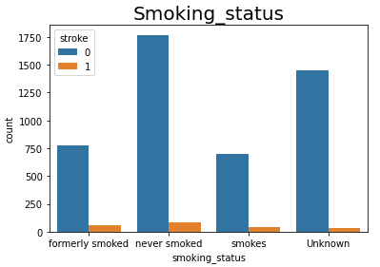
Data Visualization

Slide 13
Modeling
We use three classification algorithms for prediction result here.
Logistic Regression Classifier
K-Nearest Neighbor Classifier
Random Forest Classifier

Slide 14
Modeling
Logistic Regression Classifier
Y
Y
1
X
0
X
0 = Not at risk of brain stroke
1 = At risk of brain stroke

Slide 15
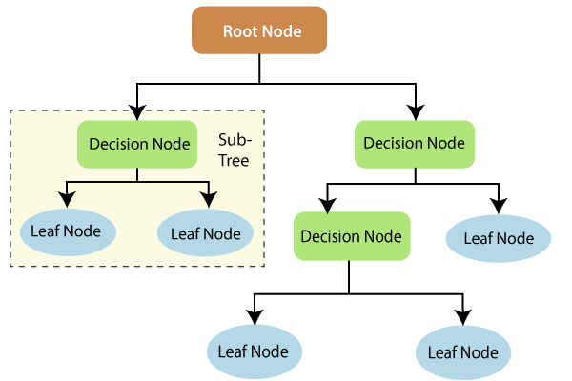
Modeling
Decision Tree Classifier

Slide 16
Modeling
Random Forest Classifier
Training Dataset
Training sample 1
Training sample 2
Training sample n
Decision tree 1
Decision tree 2
Decision tree n
Testing Dataset
Voting
Prediction

Slide 17
Evaluation
Name of Model | Accuracy score | Precision score | Recall score | F1 score
Logistic Regression | 96.33% | 98.17% | 50.91% | 50.86%
Decision Tree Classifier | 91.85% | 53.25% | 54.69% | 53.74%
Random Forest Classifier | 96.20% | 68.19% | 51.72% | 52.05%

Slide 18
Demo
https://simitun-brainstrokeproject-brain-stroke-ml-rcuvn8.streamlitapp.com/

Slide 19
Experiment
Name of Model | Accuracy score | Precision score | Recall score | F1 score
Logistic Regression | 96.33% | 98.17% | 50.91% | 50.86%
Decision Tree Classifier | 91.85% | 53.25% | 54.69% | 53.74%
K-Nearest Neighbor (KNN) | 96.27% | 48.13% | 50% | 49.05%
Naive Bayes Classifier | 86.83% | 56.56% | 71.31% | 58.20%
Random Forest Classifier | 96.20% | 68.19% | 51.72% | 52.05%
Support Vector Machine(SVM) | 96.20% | 48.13% | 49.96% | 49.03%
XGB Classifier | 96.06% | 66.43% | 53.39% | 55.05%

Slide 20
AI Ethics
Fairness
Inclusiveness
Transparency
1.
.
Our web application can be used to check whether brain stroke by both those who know about medicine and those who don’t.
1.
2.
3.
Our web application is designed to be color
blind-friendly.
It can be used for yourself safely or for the trusted others easily to check.
And cost-effective too.
1.
2.
The dataset that we use does not have an equivalent data, this is, the number of “no stroke”(0) is many times higher than the “stroke” one(1). So, there is no enough precise.
Some feature values has limits (eg. Age(0.08 – 82); so the model cannot check over limited range yet.

Slide 21
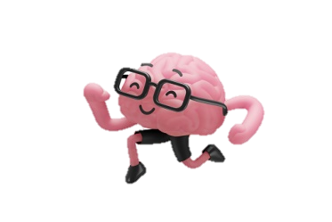
Thank you for your attention!
Q & A Time

